Slide 1


Welcome to:
5th Grade
Parent Night!
Welcome to
2nd Grade

Slide 2
Daily Schedule
Monday-Thursday
8:20- Welcome/ Calendar
8:25-9:30- Math
9:30-9:45- Recess
9:45-11:15- Reading
11:15-12:00- Lunch/ Recess
12:00-12:30- WIN
12:30-1:00- Library/Second Step/ Social Studies
1:00-1:15- Recess
1:15-1:55- Writing/ Science
1:55-2:55- Specialists (Monday-Thursday)
3:00- Home
Friday
Longer afternoon recess 1:00-1:25
2:15- Release

Slide 3

Math
Second graders will be taught:
  Math facts fluency
  Sums & differences to 100
  Place value, counting and comparing to 1,000
  Addition and subtraction within 1,000 and word problems to 100
  Foundations of multiplication and division
  Problem solving with lengths, money and data/graphs
  Telling time, shapes and an introduction to fractions

Slide 4


Reading
Introduce students to a variety of texts
  Fiction and Nonfiction
  Develop basic comprehension strategies
  Phonics (letter sounds and patterns)
  Word recognition (sight words)
  Vocabulary (able to define and use)
  Fluency- 92 wcpm by the end of the year
  INSTILL A LOVE OF READING!

Slide 5



Science & Social Studies
Science | Social Studies
Pebbles, Sand and Silt | Communities
Animals | Economics
Plants and Insects | Citizenship
Solid, Liquid and Gas | Geography

Slide 6
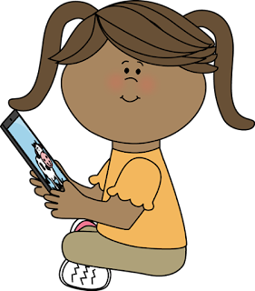
Online Resources
Math
  Happy Numbers: Math practice at their level.
  Prodigy: Math game
Reading
  Lexia: Reading, phonics and vocabulary skills
  Epic: Online books, only during school hours
  Prodigy: Reading game
Science/ Social Studies
  Mystery Science
  Scholastic News
https://grade2quacks.weebly.com

Slide 7

Grading Policy
  Students often get feedback and time to correct work during class.
  Reviewing papers with your child is a good opportunity for you to see what they are learning in class and areas where they may need more help.
  You may see a note from me asking for you to help your child at home with a certain worksheet or skill.
  Grades come from teacher observation, assessments and work that is produced in class.

Slide 8
Homework
  📚 Read! 📚
  Practice math facts
  Practice spelling patterns
  Additional work may be sent home on an individual basis.

Slide 9

🎈Birthday Celebrations🎈
No treats.
We will celebrate your child with Show & Tell or a game!
With this practice, the conversation goes from
“What did you bring us?” to “I didn’t know that about you!”
We celebrate summer birthdays on their half birthday.

Slide 10


Student & Parent Expectations
Student:
  Come to school ready to try their best!
  Be respectful and kind.
  Start independence: home and school.
Parent:
  Create routines and expectations for reading, spelling and math practice.
  Communicate questions, comments and concerns with the teacher through Class Dojo.

Slide 11


Teacher Expectations
Teachers:
  Help each child reach their full potential!
  Establish a safe learning environment.
  Create consistency with routines and expectations.
  Keep parents informed.
  Teach the Common Core State Standards.

Slide 12

Behavior
We encourage respectful behavior.
  Reoccurring behaviors will be discussed as needed.
Debug System:
  Ignore
  Move Away
  Talk Friendly
  Talk Firmly
  Get Adult Help!

Slide 13
It takes a village…
Library: Jeanne Sanford
Counselor: Aaron Schieffelbein
School Psychologist: Vickie Green
Special Education Teacher: Geri Ray
Reading Intervention: Patty Pancheri
Math Intervention: Johna Walden
Speech Pathologist: Jaime Gehrlein
Extended Learning Facilitator: Melissa Harmon
Specialists: Kathy Stefani, Lance Hamma

Slide 14




Performance Dates
Grade 5, Monster Mash
Friday, October 27
Grades 1-2, Holiday Concert
Thursday, December 14
Kindergarten, Holiday Concert
Friday, December 15
Grades 3-4, BUGZ.2
Thursday, March 7

Slide 15
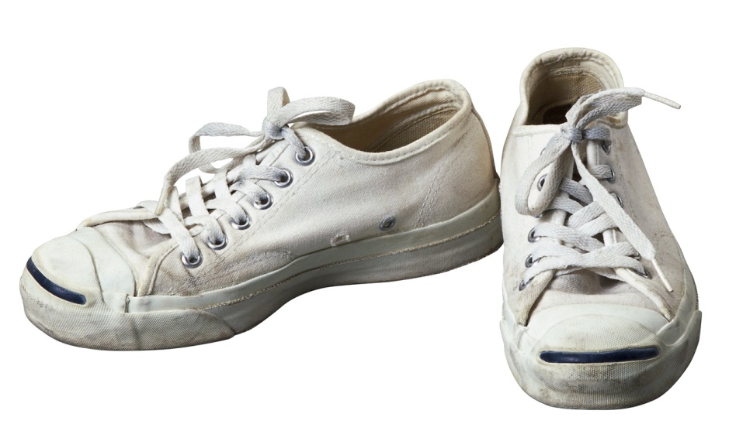
wear tennis shoes to PE Each Day!
Keep your shoes in your classroom

Slide 16


PTO
Meetings are the second Monday of the month in the school library at 6:30pm.
PTO puts on many events and fundraisers to make our school a better place to learn.
Duck Lines Directory
Staff Appreciation
Bingo Night
Read-A-Thon
Winter Ball

Slide 17

Contact Information
Class Dojo
Staff emails are available on our school website.
  Strong spam filter
  Expect under 24 hour response time.
School Phone: 208-882-0228

Slide 18
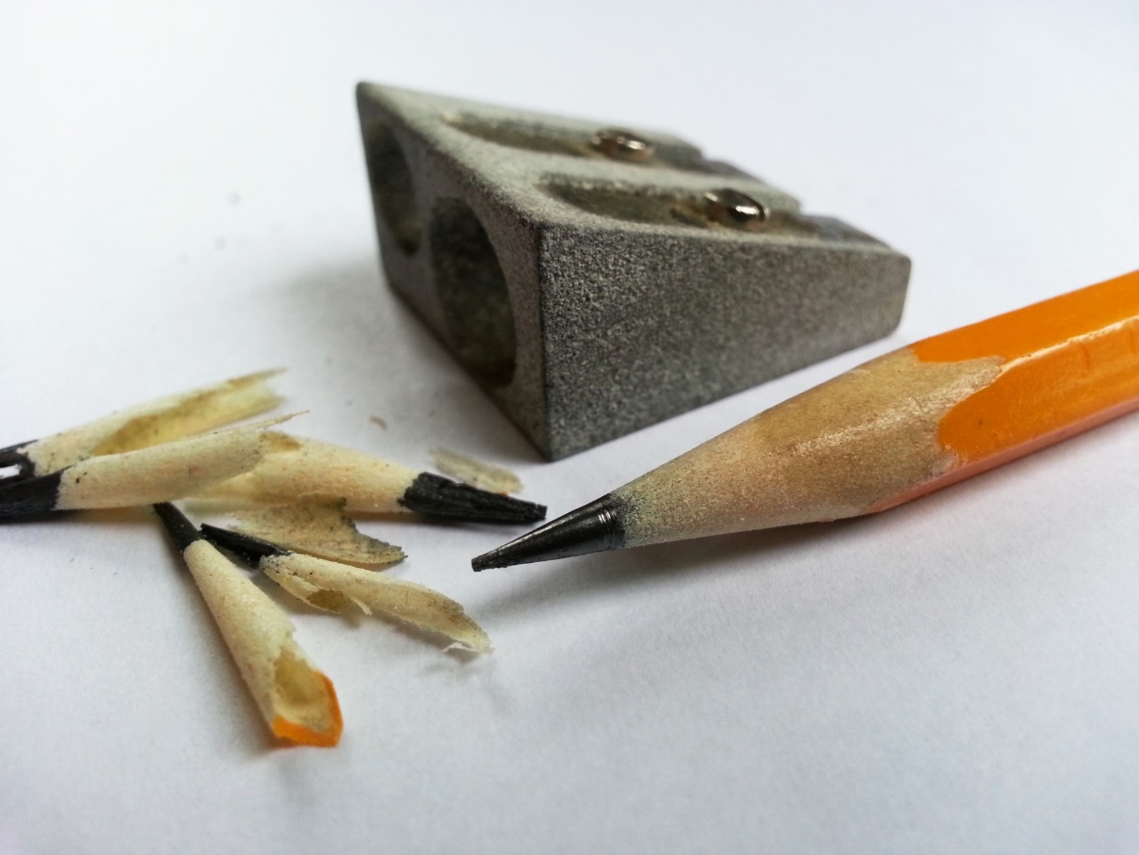
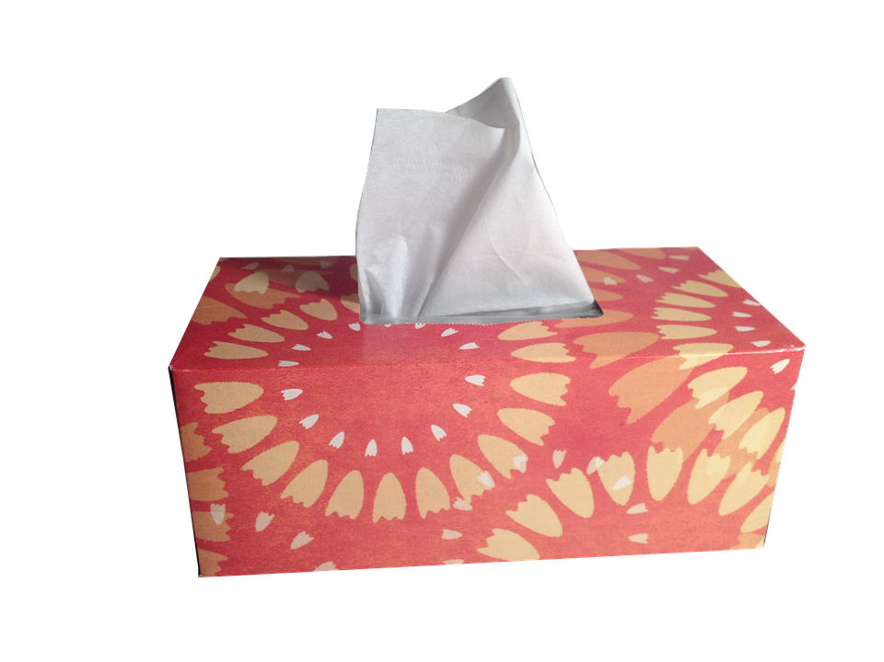
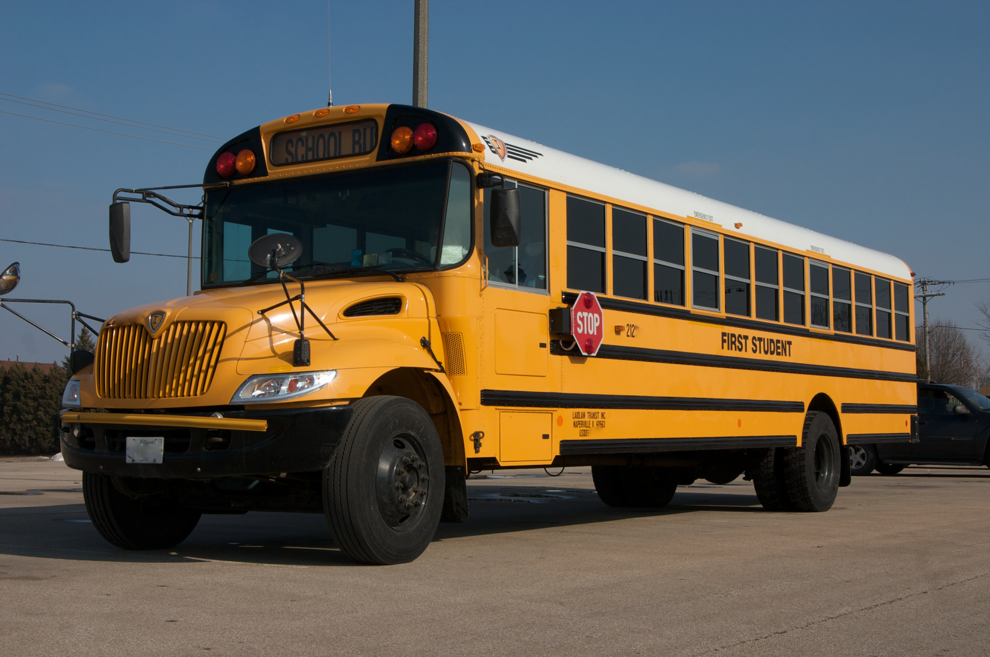
Volunteers?
☺

Slide 19

Questions?

